Slide 1
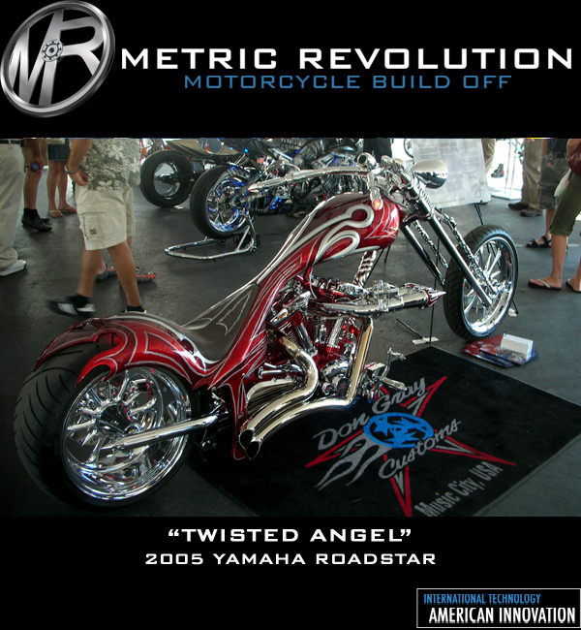
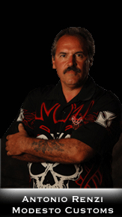
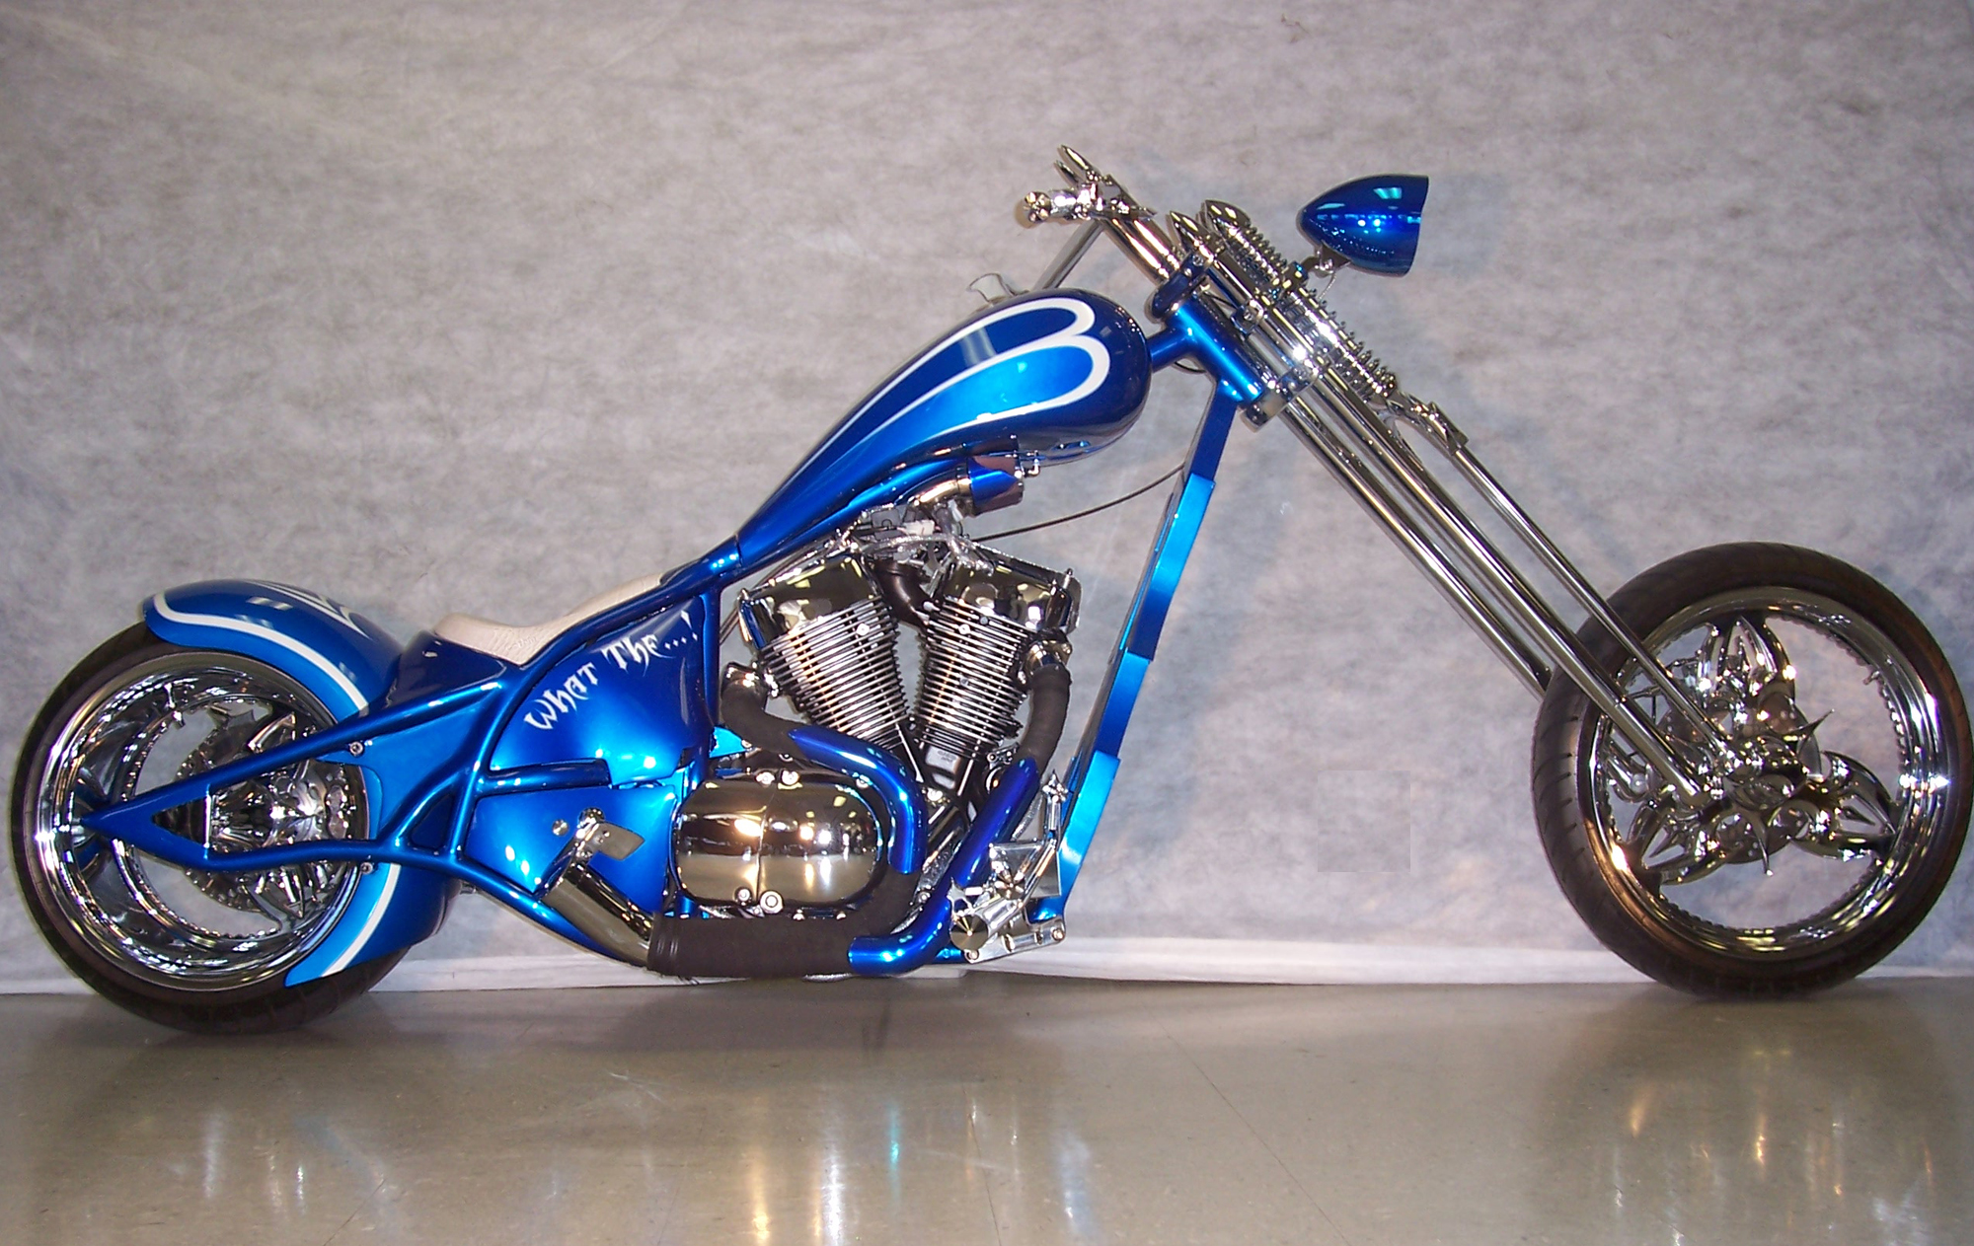
VOTE FOR ME
WATCH THE METRIC REVOLUTION
ON ESPN2
Episode 1 Starts on March 31th 2007
Metric TV Schedule on ESPN2
www.metrictv.com

Slide 2



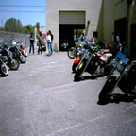
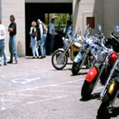

Main Vendors Arlen Ness Drag Specialties Custom Chrome Corbin Baron Barnett Goodridge Pro-One Patrick Racing Performance Machine Thunder MFG S & S Terry Components Richproducts Paul Yaffe Milwaukee Iron EGO Trip Hi Tech LED Legend RC Components Aeromach Tucker Rocky Kuryakyn Jardine Parts Unlimited
Events Below are links to three different photos. Select and image to view those photos. To return back to this page, simply close the photo you are currently viewing.
Copyright 2005 Modesto Custom Cycle Website Design By Open Sky Media

